Slide 1
Chapter 7: Microprogrammed Control
cpe 252: Computer Organization

Slide 2
Control Unit Implementation
Hardwired
Memory
Instruction code
Sequence Counter
Combinational
.
.
Control
signals
Logic Circuits
Microprogrammed
CAR: Control Address Register
CDR: Control Data Register
Memory
Instruction code
Next Address
Control
Memory
Decoding
Circuit
.
.
Control
signals
Generator
(sequencer)
CAR
CDR
cpe 252: Computer Organization

Slide 3
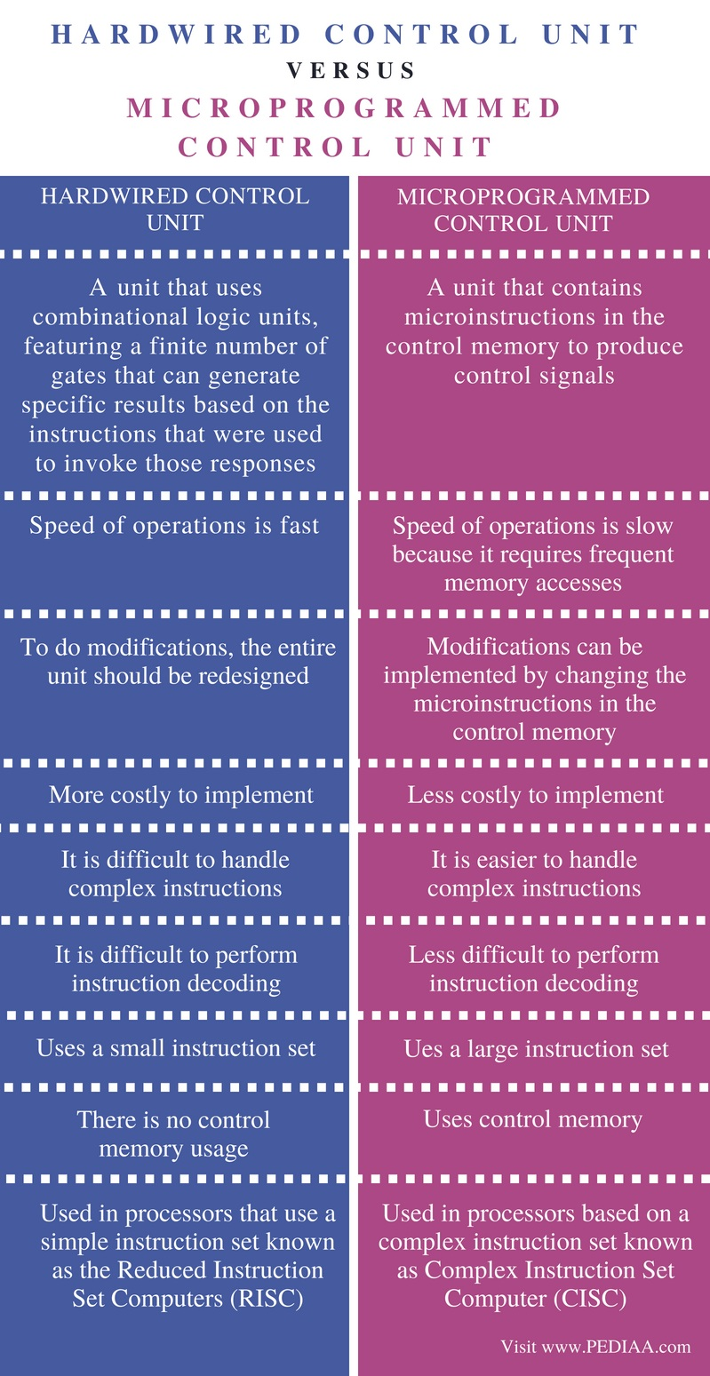
cpe 252: Computer Organization

Slide 4
Microprogrammed Control Unit
Control signals
  Group of bits used to select paths in multiplexers, decoders, arithmetic logic units
Control variables
  Binary variables specify microoperations
    Certain microoperations initiated while others idle
Control word
  String of 1’s and 0’s represent control variables
cpe 252: Computer Organization

Slide 5
Microprogrammed Control Unit
Control memory
  Memory contains control words
Microinstructions
  Control words stored in control memory
  Specify control signals for execution of microoperations
Microprogram
  Sequence of microinstructions
cpe 252: Computer Organization

Slide 6
Control Memory
Read-only memory (ROM)
Content of word in ROM at given address specifies microinstruction
Each computer instruction initiates series of microinstructions (microprogram) in control memory
These microinstructions generate microoperations to
  Fetch instruction from main memory
  Evaluate effective address
  Execute operation specified by instruction
  Return control to fetch phase for next instruction
Control memory (ROM)
Address
Control word (microinstruction)
cpe 252: Computer Organization

Slide 7
Microprogrammed Control Organization
External
input
Next Address
Control
Memory
(ROM)
Generator
(sequencer)
CAR
CDR
Control
word
Control memory
  Contains microprograms (set of microinstructions)
  Microinstruction contains
    Bits initiate microoperations
    Bits determine address of next microinstruction
Control address register (CAR)
  Specifies address of next microinstruction
cpe 252: Computer Organization

Slide 8
Microprogrammed Control Organization
Next address generator (microprogram sequencer)
  Determines address sequence for control memory
Microprogram sequencer functions
  Increment CAR by one
  Transfer external address into CAR
  Load initial address into CAR to start control operations
cpe 252: Computer Organization

Slide 9
Microprogrammed Control Organization
Control data register (CDR)- or pipeline register
  Holds microinstruction read from control memory
  Allows execution of microoperations specified by control word simultaneously with generation of next microinstruction
Control unit can operate without CDR
External
input
Next Address
Control
Memory
(ROM)
Generator
(sequencer)
CAR
Control
word
cpe 252: Computer Organization

Slide 10
Microprogram Routines
Routine
  Group of microinstructions stored in control memory
Each computer instruction has its own microprogram routine to generate microoperations that execute the instruction
cpe 252: Computer Organization

Slide 11
Microprogram Routines
Subroutine
  Sequence of microinstructions used by other routines to accomplish particular task
Example
  Subroutine to generate effective address of operand for memory reference instruction
Subroutine register (SBR)
  Stores return address during subroutine call
cpe 252: Computer Organization

Slide 12
Conditional Branching
Branching from one routine to another depends on status bit conditions
Status bits provide parameter info such as
  Carry-out of adder
  Sign bit of number
  Mode bits of instruction
Info in status bits can be tested and actions initiated based on their conditions: 1 or 0
Unconditional branch
  Fix value of status bit to 1
cpe 252: Computer Organization

Slide 13
Mapping of Instruction
Each computer instruction has its own microprogram routine stored in a given location of the control memory
Mapping
  Transformation from instruction code bits to address in control memory where routine is located
cpe 252: Computer Organization

Slide 14
Mapping of Instruction
Example
  Mapping 3-bit operation code to 7-bit address
OP-codes of Instructions
ADD AND
LDA
000
001
010
Control
memory
Mapping bits
0 xxxx 00
Address
0 0000 00
ADD Routine
0 0001 00
AND Routine
0 0010 00
LDA Routine
cpe 252: Computer Organization

Slide 15
Address Sequencing
Address sequencing capabilities required in control unit
  Incrementing CAR
  Unconditional or conditional branch, depending on status bit conditions
  Mapping from bits of instruction to address for control memory
  Facility for subroutine call and return
cpe 252: Computer Organization

Slide 16
Address Sequencing
Instruction code
Mapping
logic
Status
bits
Branch
MUX
Multiplexers
logic
select
Subroutine
Register
(SBR)
Control Address Register
(CAR)
Incrementer
Control memory (ROM)
select a status
bit
Branch address
Microoperations
cpe 252: Computer Organization

Slide 17
Microprogram Example
MUX
Computer
Configuration
10
0
AR
Address
Memory
10
0
2048 x 16
PC
MUX
6
0
6
0
15
0
DR
SBR
CAR
Control memory
Arithmetic
logic and
shift unit
128 x 20
Control unit
15
0
cpe 252: Computer Organization
AC

Slide 18
Microprogram Example
Computer instruction format
15
14
11
10
0
I
Opcode
Address
Four computer instructions
Symbol OP-code Description
EA is the effective address
  ADD 0000 AC ← AC + M[EA]
  BRANCH 0001 if (AC < 0) then (PC ← EA)
  STORE 0010 M[EA] ← AC
  EXCHANGE 0011 AC ← M[EA], M[EA] ← AC
Microinstruction Format
3
3
3
2
2
7
F1
F2
F3
CD
BR
AD
F1, F2, F3: Microoperation fields
CD: Condition for branching
BR: Branch field
AD: Address field
cpe 252: Computer Organization

Slide 19
Microinstruction Fields
F1 Microoperation Symbol
000 None NOP
001 AC ← AC + DR ADD
010 AC ← 0 CLRAC
011 AC ← AC + 1 INCAC
100 AC ← DR DRTAC
101 AR ← DR(0-10) DRTAR
110 AR ← PC PCTAR
111 M[AR] ← DR WRITE
F2 Microoperation Symbol
000 None NOP
001 AC ← AC - DR SUB
010 AC ← AC ∨ DR OR
011 AC ← AC ∧ DR AND
100 DR ← M[AR] READ
101 DR ← AC ACTDR
110 DR ← DR + 1 INCDR
111 DR(0-10) ← PC PCTDR
F3 Microoperation Symbol
000 None NOP
001 AC ← AC ⊕ DR XOR
010 AC ← AC’ COM
011 AC ← shl AC SHL
100 AC ← shr AC SHR
101 PC ← PC + 1 INCPC
110 PC ← AR ARTPC
111 Reserved
cpe 252: Computer Organization

Slide 20
Microinstruction Fields
CD Condition Symbol Comments
00 Always = 1 U Unconditional branch
01 DR(15) I Indirect address bit
10 AC(15) S Sign bit of AC
11 AC = 0 Z Zero value in AC
  BR Symbol Function
  00 JMP CAR ← AD if condition = 1
  CAR ← CAR + 1 if condition = 0
  01 CALL CAR ← AD, SBR ← CAR + 1 if condition = 1
  CAR ← CAR + 1 if condition = 0
  10 RET CAR ← SBR (Return from subroutine)
  11 MAP CAR(2-5) ← DR(11-14), CAR(0,1,6) ← 0
cpe 252: Computer Organization

Slide 21
Symbolic Microinstruction
Sample Format Label: Micro-ops CD BR AD
Label may be empty or may specify symbolic address
terminated with colon
Micro-ops consists of 1, 2, or 3 symbols separated by commas
CD one of {U, I, S, Z}
U: Unconditional Branch
I: Indirect address bit
S: Sign of AC
Z: Zero value in AC
BR one of {JMP, CALL, RET, MAP}
AD one of {Symbolic address, NEXT, empty}
cpe 252: Computer Organization

Slide 22
Fetch Routine
Fetch routine
  - Read instruction from memory
  - Decode instruction and update PC
Microinstructions for fetch routine:
AR ← PC
DR ← M[AR], PC ← PC + 1
AR ← DR(0-10), CAR(2-5) ← DR(11-14), CAR(0,1,6) ← 0
Symbolic microprogram for fetch routine:
FETCH:
ORG 64
PCTAR U JMP NEXT
READ, INCPC U JMP NEXT
DRTAR U MAP
Binary microporgram for fetch routine:
Binary
address F1 F2 F3 CD BR AD
1000000 110 000 000 00 00 1000001
1000001 000 100 101 00 00 1000010
1000010 101 000 000 00 11 0000000
cpe 252: Computer Organization

Slide 23
Design of Control Unit
microoperation fields
F1
F2
F3
3 x 8 decoder
3 x 8 decoder
3 x 8 decoder
7
6
5
4
3
2
1
0
7
6
5
4
3
2
1
0
7
6
5
4
3
2
1
0
AND
AC
DR
ADD
Arithmetic
DRTAC
logic and
shift unit
From
From
PCTAR
DRTAR
PC
DR(0-10)
Load
AC
Select
0
1
Multiplexers
Load
AR
Clock
cpe 252: Computer Organization

Slide 24
Microprogram Sequencer
External
(MAP)
I₀
L
3
2
1
0
I₁
Input
S₁
SBR
Load
logic
S₀
MUX1
T
1
Incrementer
I
MUX2
Test
S
Z
Select
Clock
CAR
Control memory
Microops
CD
BR
AD
. . .
. . .
cpe 252: Computer Organization

Slide 25
Input Logic for Microprogram Sequencer
From
CPU
1
Test
L
L(load SBR with PC) for subroutine Call
I
MUX2
T
S
BR field
of CS
Input
Z
Select
I₀
logic
S₀
S₁
for next address
selection
I₁
CD Field of CS
Input Logic
I1I0T Meaning Source of Address S₁S₀ L
000 In-Line CAR+1 00 0
001 JMP CS(AD) 01 0
010 In-Line CAR+1 00 0
011 CALL CS(AD) and SBR <- CAR+1 01 1
10x RET SBR 10 0
11x MAP DR(11-14) 11 0
S1 = I1
S₀ = I₀I₁ + I1’T
L = I₁’I0T
cpe 252: Computer Organization

